Slide 1
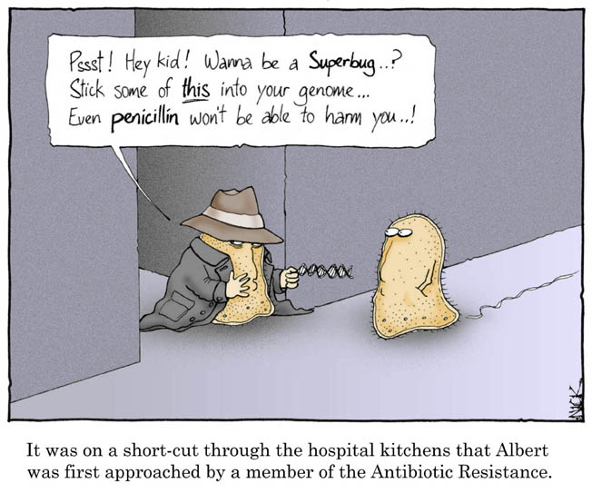
A Vanishing Cure: Growing Strains of resistant bacteria

Slide 2
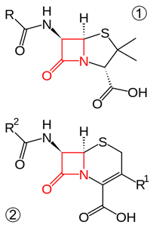
What are antibiotics
Antibiotics are fungi drugs that can kill or stop reproduction of bacteria
Penicillin, one of the more common, is part of the β-lactam antibiotic family
Note: four atom ring

Slide 3
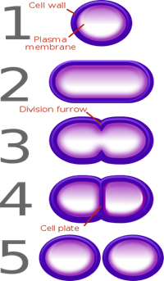
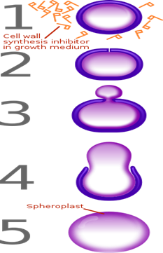
How Penicillin works
Penicillin inhibits cell wall synthesis in bacteria
When the bacteria tries to reproduce, a new cell wall can’t be formed causing the bacteria to slip out of its cell wall and becomes vulnerable to the world around it.

Slide 4
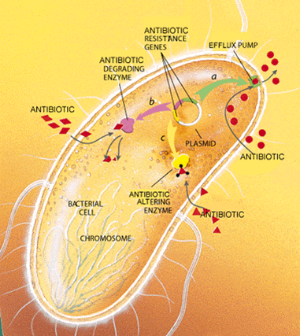
Antibiotic Resistance
occurs when a bacterium acquires a gene that enables it to produce proteins that can alter, degrade, or pump the antibiotic out of the cell

Slide 5
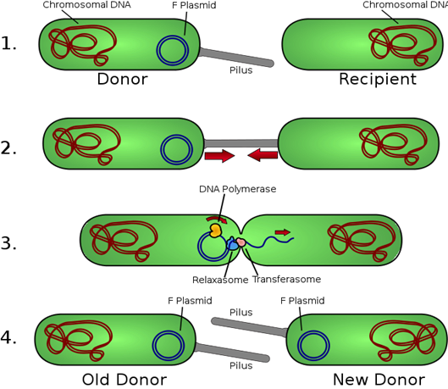
Ways of acquiring genes
Transformation: picks up DNA fragments from dead cells
Transference of circular pieces of DNA called plasmids via pili, small hair like projection used to help fuse cell membranes

Slide 6
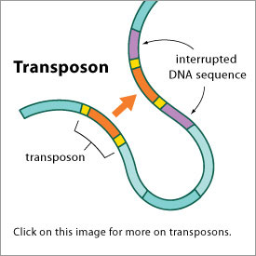
Ways of acquiring genes (cont.)
Transposons: “jumping genes” Sequences of DNA that can jump from place to place in a DNA strand, a phenomenon that can result in significant mutations in the DNA thus creating a new gene by chance.

Slide 7
Destroying Antibiotics
The gene responsible for β-lactam antibiotic resistance enables the antibiotic resistant microbe to produce and enzyme called β-lactamase.
β-lactamase breaks down the most important element of β-lactam’s molecular structure which is its four atom ring.

Slide 8
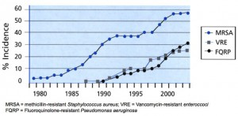
Is it really that big of a deal?
What do you think happens when a strain of bacteria is resistant to antibiotics?
Doesn’t mean the bacteria is stronger, however your body becomes the last line of defence.
“Each year these superbugs are responsible for 400,000 infections, 2.5 million hospital days and 25,000 deaths in Europe alone.”

Slide 9
For instance
“Since the 1940s, the sexually transmitted disease known as "the clap" has been easily treated with antibiotics. But the new strain of Neisseria gonorrhoeae has genetically mutated to evade cephalosporins -- the only antibiotics still effective against the infection. “
“Japanese researchers made the finding after testing 259 MRSA strains for susceptibility to bacitracin and neomycin, two of the antibacterial ingredients commonly found in over-the-counter ointments like Neosporin and Polysporin. Resistance to bacitracin and neomycin was only found in USA300, a type of MRSA found in the United States.”
“Among 536 cases of tuberculosis confirmed at a rural hospital in South Africa earlier this year, 41% were multi-drug resistant and of those, 24% met the exact definition of being extensively drug resistant tuberculosis (also referred to as XDR tuberculosis). Such tuberculosis is almost untreatable”

Slide 10
Enabling Antibiotic Resistance: Overuse
Over-the-counter triple antibiotics
“40% of Mongolian children are given antibiotics without a prescription for a respiratory tract infection.”
Parents pressuring doctors out of fear for their children. (when in reality it’s doing harm!) “Many non-clinical factors influence physicians’ prescribing practices, but parental pressure and fear of losing patients are commonly cited by physicians as factors in their decisions whether or not to prescribe antibiotics.”

Slide 11
Enabling Antibiotic Resistance: Overuse
“In Canada and the United States, it is estimated that physicians overprescribe antibiotics by 50%. Furthermore, advertising is contributing to the problem. Physicians report that more patients are requesting specific drugs as a result of TV, Internet, magazine, or newspaper advertising, and cite patient pressure as the number one reason why they prescribe drugs they might otherwise have avoided. And teaching hospitals sometimes promote prescribing practices that contribute to drug resistance. Studies undertaken at teaching hospitals worldwide found that between 40% and 91% of antibiotics prescribed were inappropriate.”

Slide 12
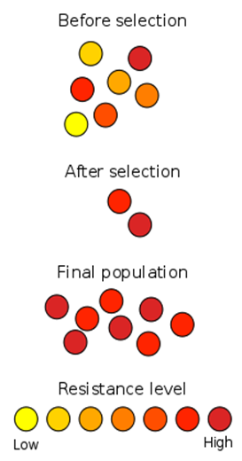
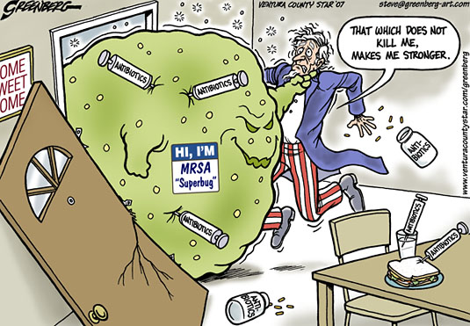
Enabling Antibiotic Resistance: Misuse
Not following prescription instructions.
Not finishing prescription
Sharing presciption

Slide 13
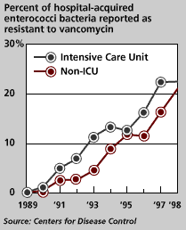
Enabling Antibiotic Resistance: Healthcare
Hospitals are places where people with open wounds, bodily dysfunctions, broken limbs, and a great variety of illnesses go to get better
“In a recent survey of physicians, 45% considered poor hand washing practices an important cause of antimicrobial drug resistance in hospitals.”
“In the United States, as many as 60% of hospital-acquired infections are caused by drug-resistant microbes; and, VRE and MRSA-once confined to hospitals--have migrated to the community at large.”

Slide 14
What we can do to stop it
Rotating antibiotics
Like Momma used to say “Every child should eat a pound of dirt before they’re three years of age”
Organic medical techniques could be used in instances where your body could use an effective immune response would kill the bacteria and lower antibiotic resistance.
More organic solutions have already been approached in poultry farms. “Findings suggest that the voluntary removal of antibiotics from large-scale U.S. poultry farms that transition to organic practices is associated with a lower prevalence of antibiotic-resistance.”

Slide 15
Antimicrobial technology
Dr. Richard Scott, Vice President of Research at PolyMedix, presented data on PolyMedix's new class of defensin-mimetic antibiotics, including PMX-30063. Dr. Scott's presentation highlighted significant attributes of PolyMedix's defensin-mimetic (Defensisns are antibiotic peptides utilized by our body in microbial defense) antibiotics including, the novel mechanism of action which mimics innate human immunity and makes bacterial resistance unlikely to develop, the unique resistance profile which exerts bactericidal activity against bacteria that are resistant to conventional antibiotics, the basic principles underlying the antimicrobial activities of the defensin-mimetics, the spectrum of activity against Gram-positive and Gram-negative pathogens, and the wide selectivity for bacteria over mammalian cells.”

Slide 16
Work Cited
Paluck, E., PHD., Katzenstein, D., MA., Frankish, C. J., PHD., Herbert, C. P., MD,CCFP., Milner, R., MSC., Speert, D., MD., & Chambers, K., MD, MHSC, CCFP. (2001, March). Prescribing practices and attitudes toward giving children antibiotics. Containing antimicrobial resistance: a renewed effort. (n.d.). Retrieved December,
Beta-lactam antibiotic. (n.d.). Retrieved from Wikipedia website: Http://en.wikipedia.org/wiki/Beta-lactam_antibiotic
Beta-Lactamase. (n.d.). Retrieved from Wikipedia website: http://en.wikipedia.org/wiki/File:Lactamase_Application_V.1.svg
Pilus. (n.d.). Retrieved from Wikipedia website: http://en.wikipedia.org/wiki/Pilus
Petersen, D. M. (2009, December 16). Dealing with the monsters we've created. Dynamic Chiropractic, 27(26). Retrieved from thtp://go.galegroup.com/ps/i.do?&id=GALE%7CA218974654&v=2.1&u=gale15690&it=r&p=AONE&sw=w
Sapkota AR, Hulet RM, Zhang G, McDermott P, Kinney E, et al. 2011 Lower Prevalence of Antibiotic-resistant Enterococci On U.S. Conventional Poultry Farms That Transitioned to Organic Practices. Environ Health Perspect doi:10.1289/ehp.1003350
Weber, C. J. (2006, February). Update on antimicrobial resistance. Dermatology Nursing, 18(1), 15+. Retrieved from http://go.galegroup.com/ps/i.do?&id=GALE%7CA142206533&v=2.1&u=gale15690&it=r&p=AONE&sw=w
http://thechart.blogs.cnn.com/2011/09/14/mrsa-in-u-s-becoming-resistant-to-over-the-counter-ointment
http://abcnews.go.com/Health/Wellness/super-gonorrhea-scientists-discover-antibiotic-resistant-std/story?id=14027745/?iref=allsearch
http://www.sciencedaily.com/releases/2006/09/060915202534.htm

